Slide 1
Object-Oriented Software Engineering
Practical Software Development using UML and Java
Chapter 9:
Architecting and Designing Software

Slide 2
The Process of Design
Definition:
  Design is a problem-solving process whose objective is to find and describe a way:
    To implement the system’s functional requirements...
    While respecting the constraints imposed by the quality, platform and process requirements...
      including the budget
    And while adhering to general principles of good quality

Slide 3
Making decisions
To make each design decision, the software engineer uses:
  Knowledge of
    the requirements
    the technology available
    software design principles and ‘best practices’
    what has worked well in the past

Slide 4
Parts of a system: subsystems, components and modules
Component
  Any piece of software or hardware that has a clear role.
  Many components are designed to be reusable.
    user interface for a particular system.
    Other components include source code files, executable files,
    and databases.

Slide 5
Module
A component that is defined at the programming language level
  For example, methods, classes and packages are modules in Java.

Slide 6
System
A logical entity, having a set of definable responsibilities or objectives, and consisting of hardware, software or both.
  A system can have a specification which is then implemented by a collection of components.
  Subsystem:
    A system that is part of a larger system, and which has a definite interface .

Slide 7
Top-down and bottom-up design
Top-down design
  First design the very high-level structure of the system.
  Then gradually work down to detailed decisions about low-level constructs.
  Finally arrive at detailed decisions such as:
    the format of particular data items;
    the individual algorithms that will be used.

Slide 8
Top-down and bottom-up design
Bottom-up design
  Make decisions about reusable low-level utilities.
  Then decide how these will be put together to create high-level constructs.
A mix of top-down and bottom-up approaches are normally used:
  Top-down design is almost always needed to give the system a good structure.
  Bottom-up design is normally useful so that reusable components can be created.

Slide 9
Different aspects of design
  Architecture design:
    The division into subsystems and components,
      How these will be connected.
      How they will interact.
      Their interfaces.
  Class design:
    The various features of classes.
  User interface design
  Algorithm design:
    The design of computational mechanisms.
  Protocol design:
    The design of communications protocol.

Slide 10
Principles Leading to Good Design
Overall goals of good design:
  Increasing profit by reducing cost and increasing revenue
  Ensuring that we actually conform with the requirements
  Accelerating development
  Increasing qualities such as
    Usability
    Efficiency
    Reliability
    Maintainability
    Reusability

Slide 11
Design Principle: Divide and conquer
Trying to deal with something big all at once is normally much harder than dealing with a series of smaller things
  Separate people can work on each part.
  Each individual component is smaller, and therefore easier to understand.
  Parts can be replaced or changed without having to replace or extensively change other parts.

Slide 12
Ways of dividing a software system
  A distributed system is divided up into clients and servers
  A system is divided up into subsystems
  A subsystem can be divided up into one or more packages
  A package is divided up into classes
  A class is divided up into methods

Slide 13
Design Principle: Increase cohesion where possible
The cohesion principle is an extension of the divide and conquer principle –divide and conquer simply says to divide things up into smaller chunks.
Cohesion says to do it intelligently: yes, divide things up, but keep things together that belong together.

Slide 14
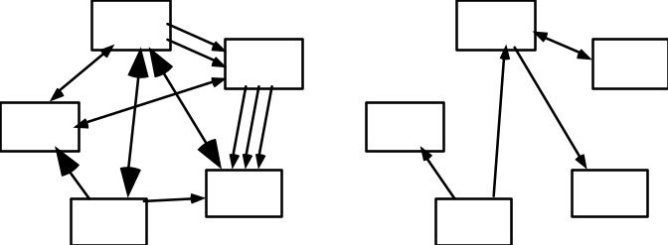
Design Principle: Reduce coupling where possible
Coupling occurs when there are interdependencies between one module and another
  When interdependencies exist, changes in one place will require changes somewhere else.
  A network of interdependencies makes it hard to see at a glance how some component works.
Notes:
Cohesion: Is module, system or components is performing relevant functionality (high cohesion) otherwise it is low cohesion. Like a payment module not expected to do user authentication which is responsibility of another module and can arise difficulty in future when changes are required.
Coupling: How much components are dependent on each other. Low coupling make modifications easier. High coupling can cause changing in one piece of code required to review all the other dependent components as well.

Slide 15
Design Principle: Increase reusability where possible
Design the various aspects of your system so that they can be used again in other contexts
  Generalize your design as much as possible
  Design your system to contain hooks
  Simplify your design as much as possible

Slide 16
Design Principle: Reuse existing designs and code where possible
Design with reuse is complementary to design for reusability
  Actively reusing designs or code allows you to take advantage of the investment you or others have made in reusable components

Slide 17
Design Principle: Design for Portability
Have the software run on as many platforms as possible
  Avoid the use of facilities that are specific to one particular environment .

Slide 18
Software Architecture
Software architecture is process of designing the global organization of a software system, including:
  Dividing software into subsystems.
  Deciding how these will interact.
  Determining their interfaces.
    The architecture is the core of the design, so all software engineers need to understand it.
    The architecture will often constrain the overall efficiency, reusability and maintainability of the system.

Slide 19
Architectural Patterns
The notion of patterns can be applied to software architecture.
  These are called architectural patterns or architectural styles.
  Each allows you to design flexible systems using components
    The components are as independent of each other as possible.

Slide 20
The Multi-Layer architectural pattern
In a layered system, each layer communicates only with the layer immediately below it.
  Each layer has a well-defined interface used by the layer immediately above.
    The higher layer sees the lower layer as a set of services.
    It is important to have a separate layer for the UI.
    Layers immediately below the UI layer provide the application functions determined by the use-cases.
    Bottom layers provide general services.
      e.g. network communication, database access

Slide 21
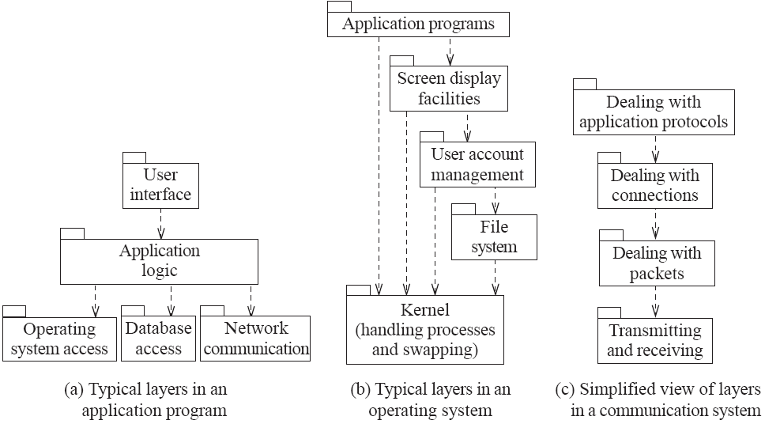
Example of multi-layer systems

Slide 22
The Client-Server architectural pattern
  There is at least one component that has the role of server, waiting for and then handling connections.
  There is at least one component that has the role of client, initiating connections in order to obtain some service.

Slide 23
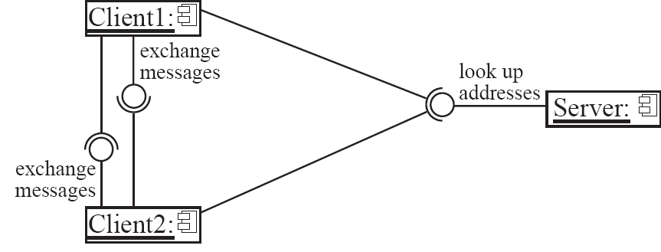
An example of a distributed system

Slide 24
The Pipe-and-Filter architectural pattern
A stream of data, in a relatively simple format, is passed through a series of processes
  Each of which transforms it in some way.
  Data is constantly fed into the pipeline.
  The architecture is very flexible.
    Components could be replaced.
    New components could be inserted.
    Certain components could be reordered.

Slide 25
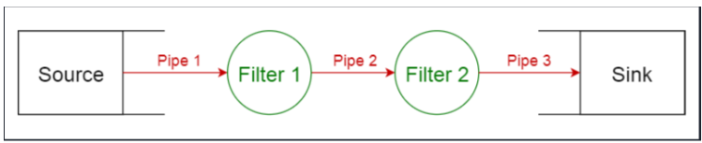
The Pipe-and-Filter architectural pattern
A pipeline consist of a chain of processing elements arranged so that the output of each element is the input of the next element.
Conceptually, it should have a source to provide the initial data. And then step by step the data will be passed through filters over the pipes.
And each filter supposes to transform the data provided and hand over the transformed data to the next filter through a pipe. Finally transformed data is handed over the final destination called "Sink".

